Slide 1
NETWORK TRAFFIC ANALYSER FOR DETECTING DoS ATTACK USING MACHINE LEARNING
By Group-17 Guide:-
Anshul Agrawal (190851923002) Mr. Muraleedharan N
Chandan singh (190851923007)
Suggala Bhargavi (190851923031)
Sumesh Stanley Lobo (190851923033)
Madala Akhil (190851920039)

Slide 2
SCOPE
To generate normal traffic, DoS traffic and convert them to CSV file.
Train the system to Classify normal traffic and DoS traffic using machine learning.

Slide 3



What is Denial-of-Service?
Denial-of-Service attack is an attack meant to shut down a machine or network, making it inaccessible to its intended users.
Accomplish this by flooding the target with traffic or sending it information that triggers a crash.
Often target web servers of high-profile organizations such as banking, commerce, and media companies or government and trade organizations.
DoS attacks do not typically result in the theft or loss of information or other assets but cost the victim a great deal of time and money.
Open port. Waiting for 'ACK.
Open port. Waiting for 'ACK
Open port. Waiting for ACK
Open port. Waiting for 'ACK:
Connectionsexhausted

Slide 4
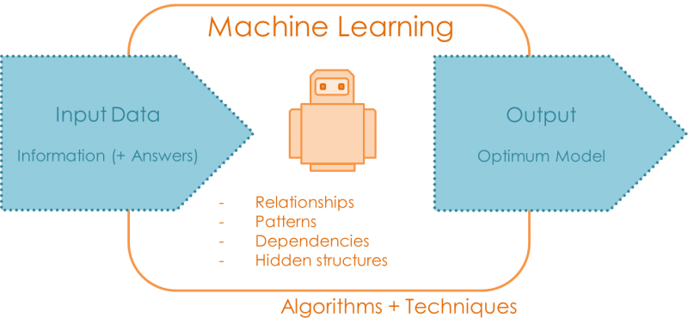
Machine Learning
Can be defined as the practice of using algorithms to extract data, learn from it, and then forecast future trends.
Branch of Artificial Intelligence based on the idea that systems can learn from data, identify patterns and make decisions with minimal human intervention.
Comprises of statistical analysis and predictive analysis that is used to spot patterns and hidden insights based on perceived data.

Slide 5
Outline
Using machine learning the system is trained to classify the incoming traffic as
Normal traffic or
Malicious packets in particular denial of service attack.
The tools used to achieve this are
Wireshark - incoming packets are captured and sent as a csv file to pandas
Anaconda navigator – GUI helps to manage packages.
Matplotlib - visualize the normal and DoS packets
Scikit learn - train the system so that it detects and classifies the dos packets.

Slide 6
Flow Diagram
Traffic
INTERNET
NTA
INTERNAL NETWORK

Slide 7
Flow Diagram
Wireshark
CSV file
Pandas
Packets
Scikit Learn
Matplotlib

Slide 8
Softwares
Wireshark
Pandas
Matplotlib
Scikit-Learn

Slide 9
Wireshark
GUI-based network protocol analyzer.
Capture data packets in network or read packets from a previously saved files.
Uses pcap library to capture traffic from the first available network interface and display a summary.
Save the captured data as CSV files.

Slide 10
Pandas/NumPy
Pandas Stands for "Python Data Analysis Library”.
Pandas takes data (like a CSV or TSV file, or a SQL database) and creates a Python object with rows and columns called data frame that looks very similar to table in a statistical software.
NumPy stands for Numerical python.
It is a library consisting of multi-dimensional array objects and a collection of routines for processing these Array.
Using NumPy mathematical and logical operation on arrays can be performed.

Slide 11
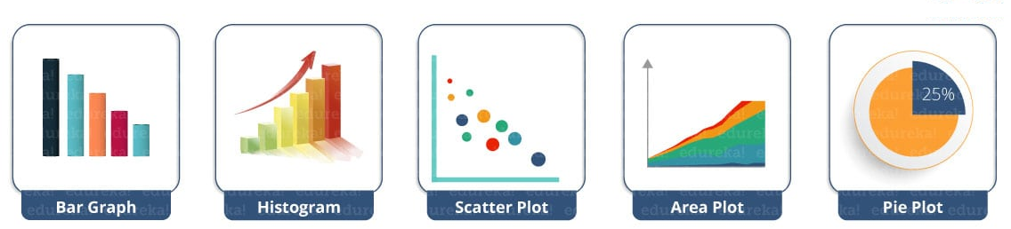
Matplotlib
Matplotlib.pyplot - plotting library used for 2D graphics in python.
Can be used in
Python scripts
Shell scripts
Web application servers
Other graphical user interface toolkits.
Python Matplotlib : Various types of Plots can be created

Slide 12
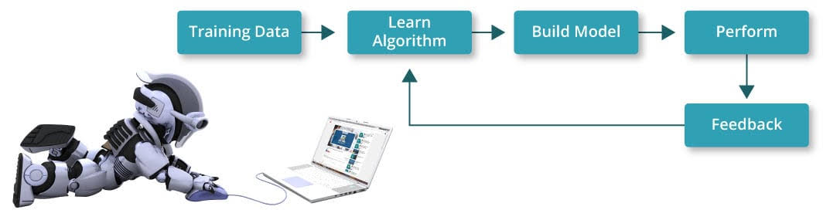
Scikit
Formerly scikits.Learn and also known as sklearn
Free software machine learning library for the python programming language.
Features various classification, regression and clustering algorithms.
Algorithms used are Decision Tree and Random forest.

Slide 13
Machine Learning
Start of ML steps
Import the data
END
Clean the data
Split the data into Input/output sets
Evaluate and Improve
Create a model
Train the model
Make Predictions

Slide 14
Thank You

